Slide 1
Deploying Open5g applications with continuous integration
PROJECT GUIDE: GROUP MEMBERS:
Debobroto Das Robin, Akhil Reddy Nalla (811172556)
Professor Divya Sri Karingula (811172271)

Slide 2
Milestone 1 Recap
In previous we have discussed how the developer will create a branch to push their code in our repository.
Set up Ec2 instances
Set up Ubuntu machines
Set up Docker Engine
Set Jenkins instance
Creating a docker script and downloading the components from GitHub.

Slide 3
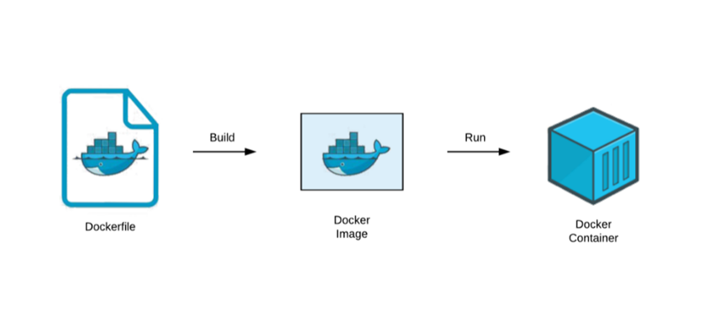
Milestone 2 Overview
In this project we will clone the code and write Docker files, build Docker images and we are going to run in docker containers.
We are going to use Jenkins pipeline to do continues integration/ continues development (CI/CD) of open 5g applications.

Slide 4
AWS Service
AWS Management console will provide multiple ways for navigating to individual service console
Amazon Elastic Compute Cloud (Amazon EC2) provides scalable computing capacity in the Amazon Web Services (AWS) Cloud.
Block storage It is a technology which stores the data and divides the data into blocks for fast access.
Security Policy for inbound value of ports access
IAM It is a web service which gives the secure access to aws resources

Slide 5
Tools used
GitHub Code Repo
AWS Service
Docker Engine
Docker Hub Registry
Jenkins

Slide 6
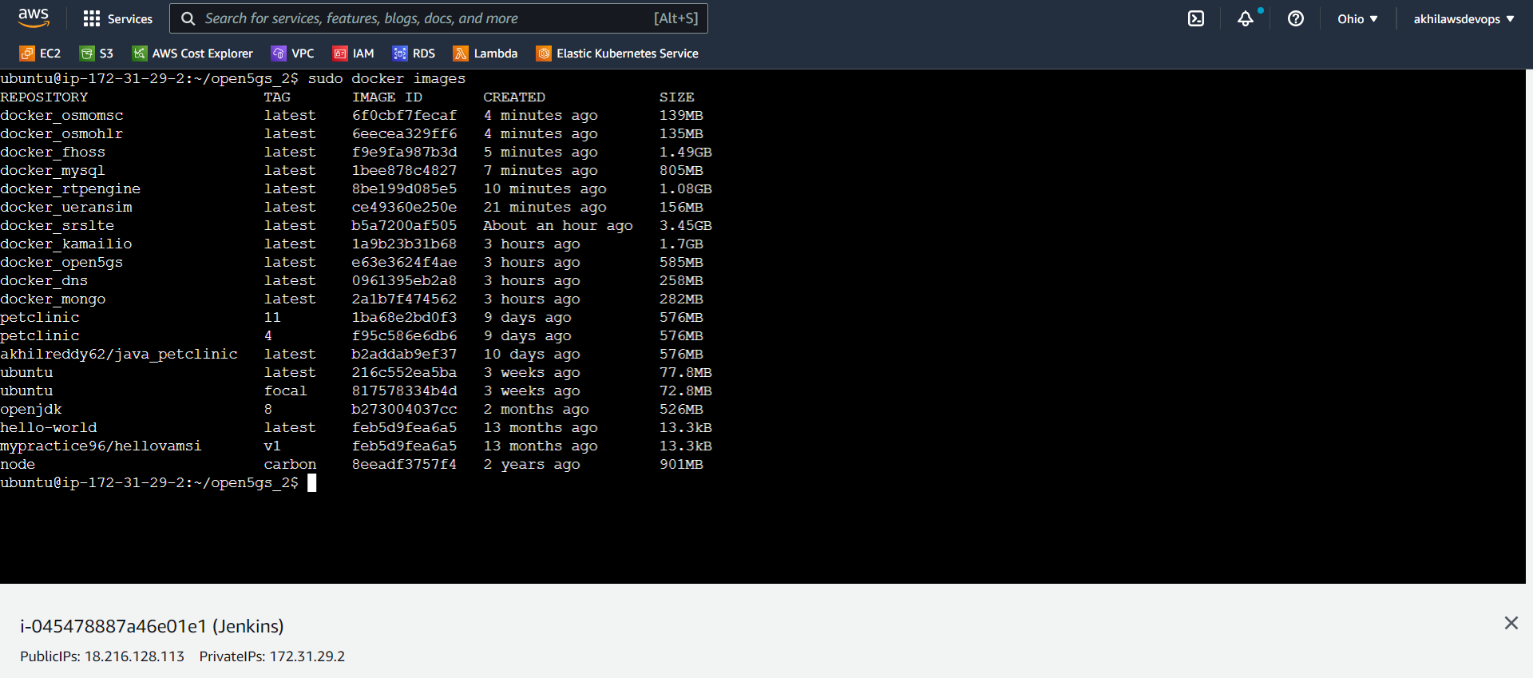
Docker Images

Slide 7
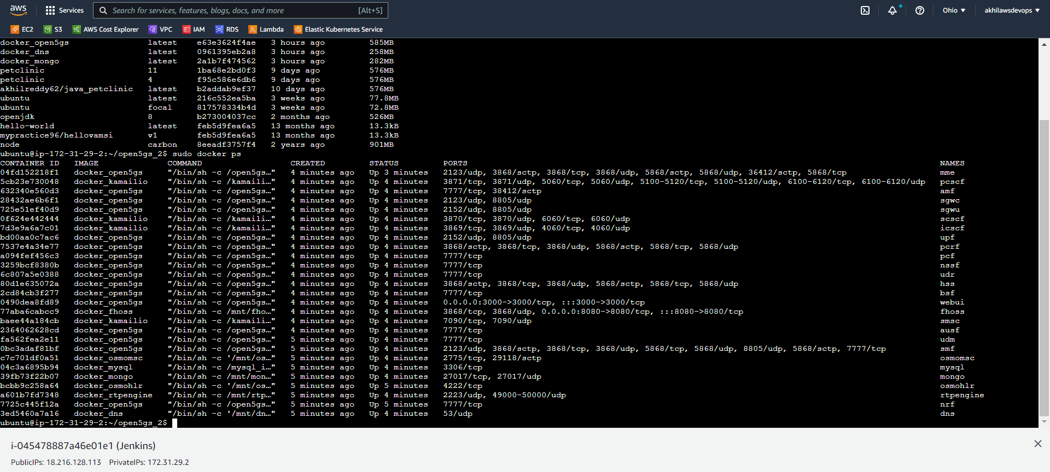
Docker Containers

Slide 8
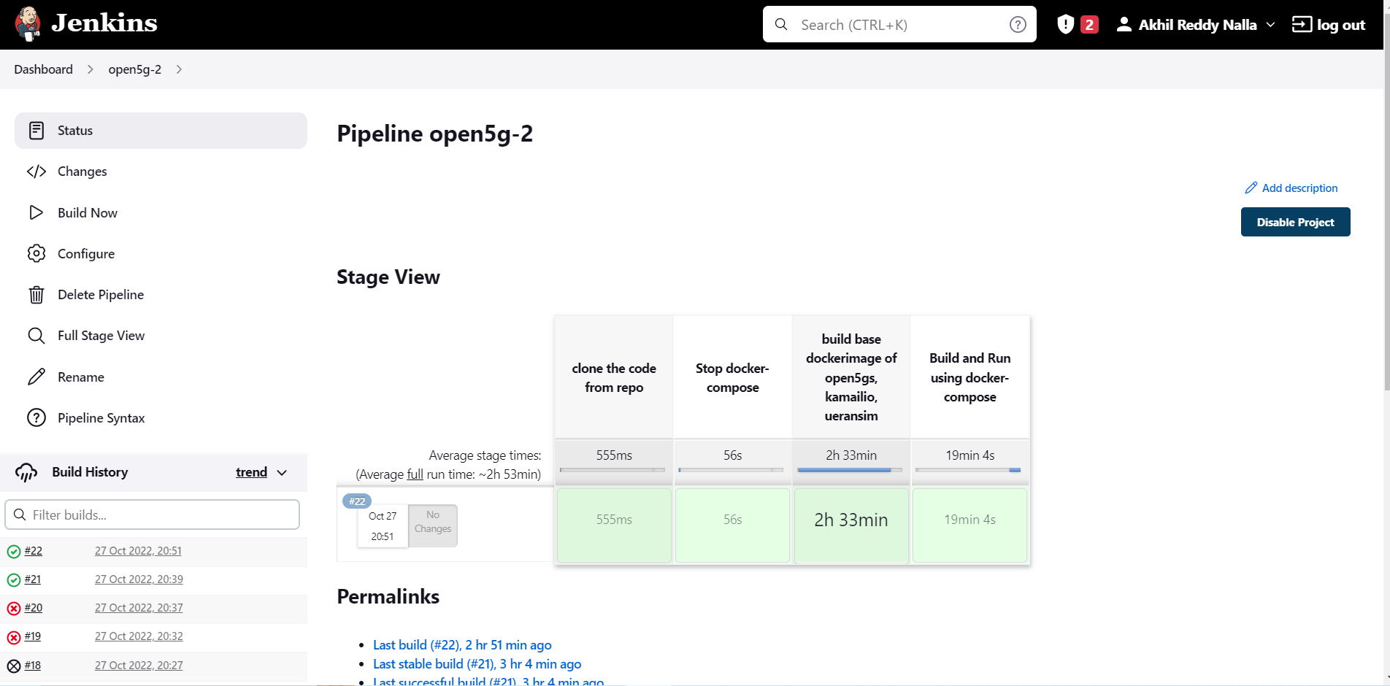
Jenkins

Slide 9
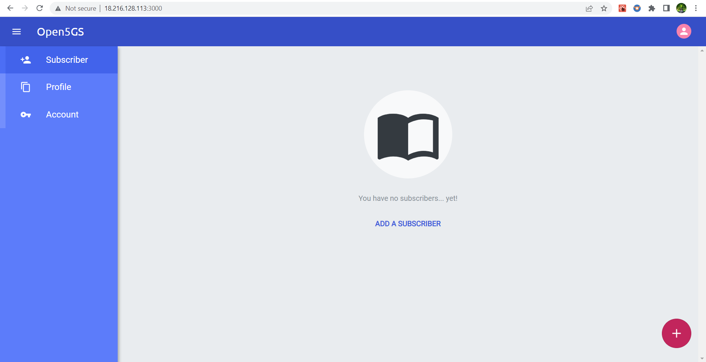
Open5g Application

Slide 10
Implementation
Demo

Slide 11
References
https://github.com/open5gs/open5gs
Nikolaos Apostolakis, Marco Gramaglia, and Pablo Serrano - Design and Validation of an Open Source Cloud Native Mobile Network
https://open5gs.org/open5gs
https://medium.com/rahasak/5g-core-network-setup-with-open5gs-and-ueransim-cd0e77025fd7
Docker Hub Account: https://hub.docker.com/u/akhilreddy62
GitHub Repo link: https://github.com/AkhilReddy62/open5gs_2

Slide 12
Thank You.
www.kent.edu

